Slide 1
QrCode System
- Hackathon Team

Slide 2
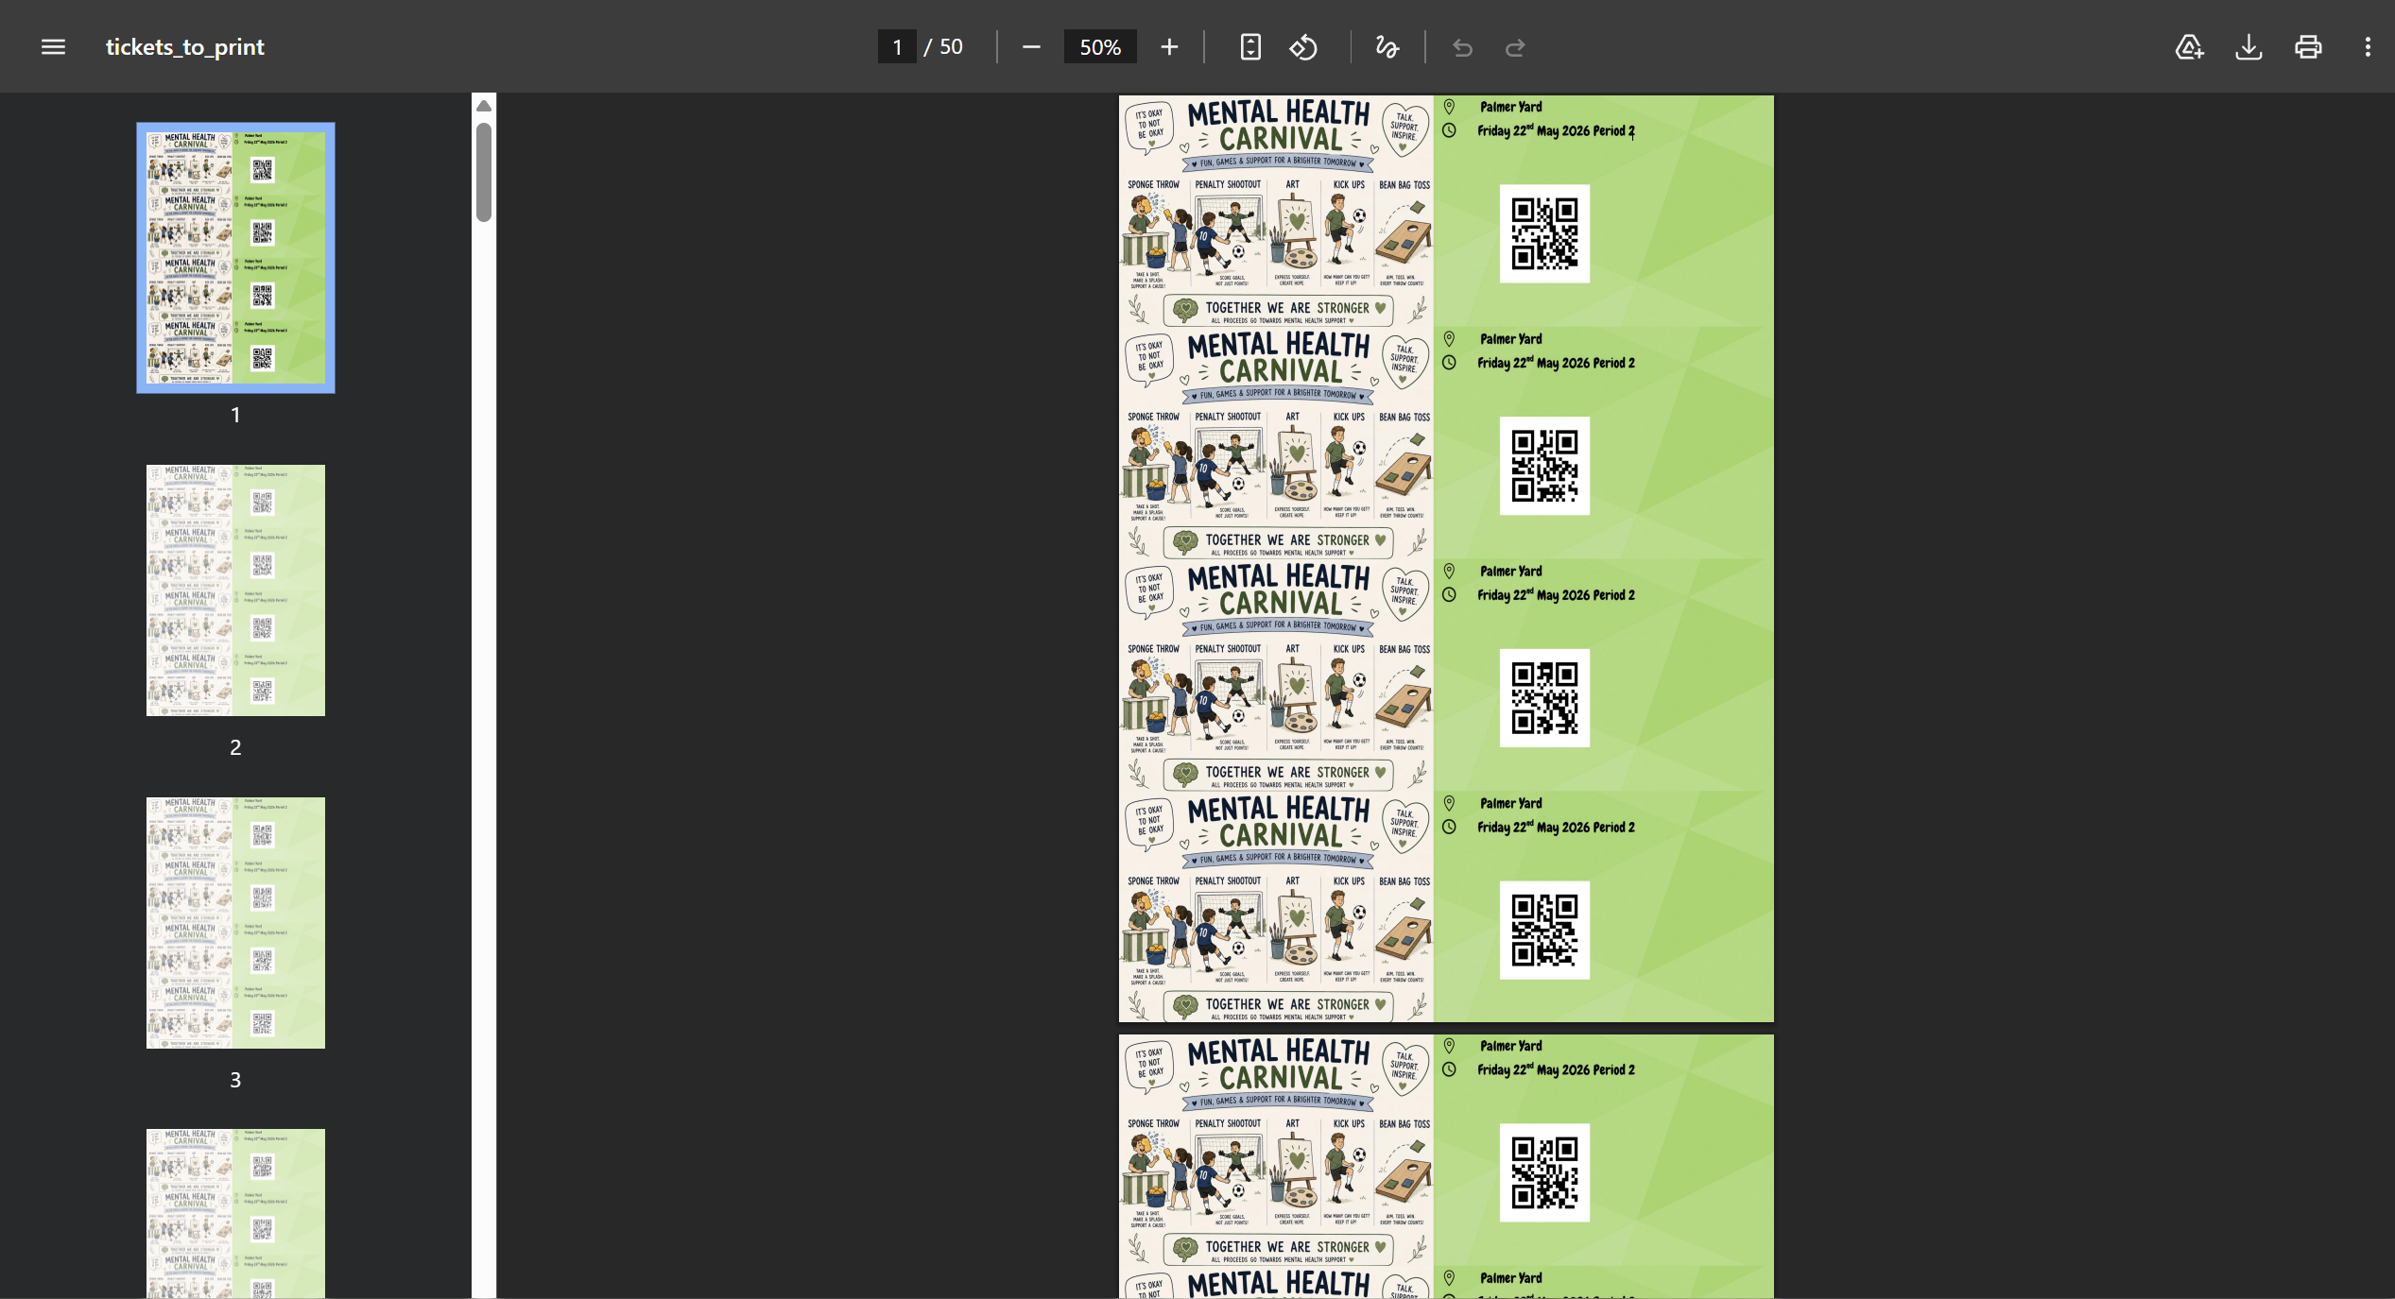

Tickets
200 premade tickets are made, all of them have random QrCodes stuck on them. The code also makes a printable PDF with all the tickets which makes it very easy to print. All of this is very customisable, you can have more tickets per page to use less paper, make the QrCode bigger or smaller or have a unique design to it.
Figure 1: The PDF with all the tickets.
Figure 2: A single ticket with a QrCode

Slide 3
Website
Up to 8 people can connect to the website at any given time. All you have to do is scan a QrCode, Enter the details and that’s it. All of the details are saved to a database and a spreadsheet, which is organized by year group and form.
There is going to be a small demo

Slide 4
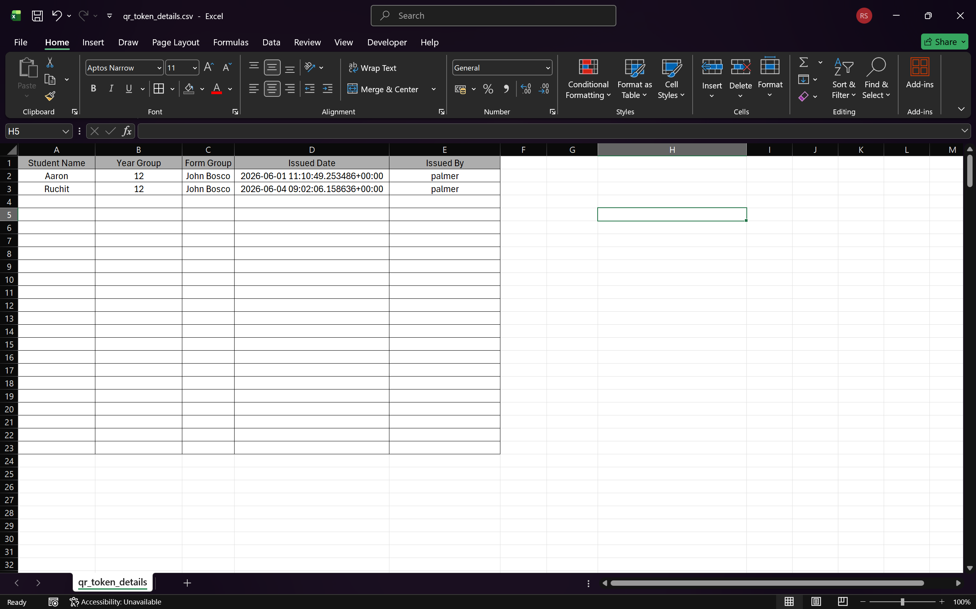
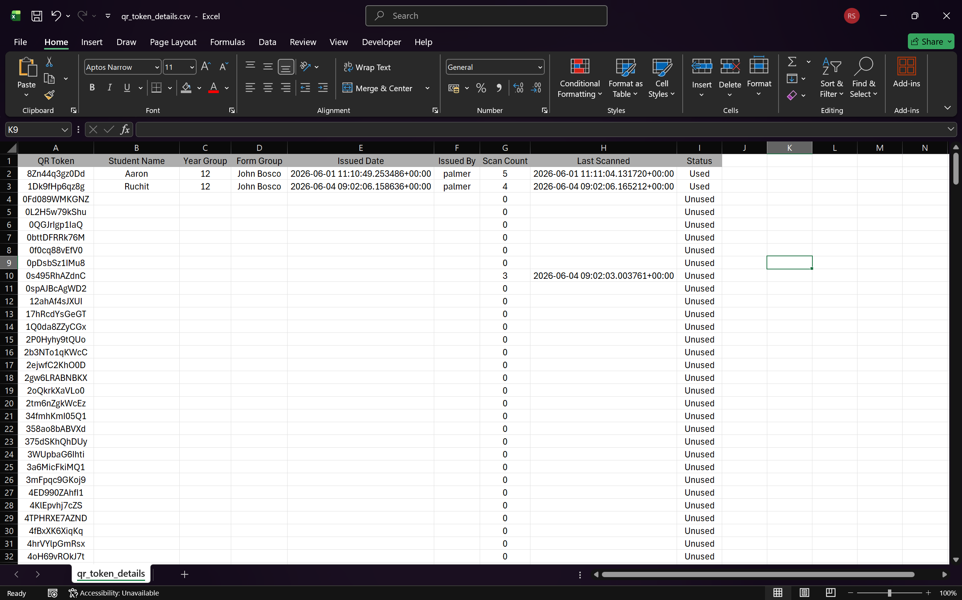
The spreadsheet
As you keep scanning, the spread gets updated. The spreadsheet organizes the students and groups them by year and form.

